Slide 1
ACCENTURE

Slide 2
REASONING ABILITY

Slide 3
1. Complete the number series.
3, 6, 8, 16, 18, ……?
(a) 28
(b) 36
(c) 54
(d) 34

Slide 4
2. Fill the (?) in order to complete the number series.
(?), 19, 37, 61, 91, 127, 169
(a) 17
(b) 13
(c) 11
(d) 7

Slide 5
3. Complete the following series.
DE, GHI, KLMN, _________, VWXYZA
(a) PSRTQ
(b) OQSTU
(c) PQRST
(d) OPSRU
(e) QRSTU

Slide 6
4. Use English alphabets and find the correct answer of the given question.
A B C D E F G H I J K L M N O P Q R S T U V W X Y Z
Complete the given series.
P, L, R, M, T, N, V, O, X, _____
(a) Z
(b) P
(c) Q
(d) A

Slide 7
5. Use English alphabets and find the correct answer of the given question.
A B C D E F G H I J K L M N O P Q R S T U V W X Y Z
What will be the next letter in the following series?
E, F, H, K, O, ?
(a) R
(b) S
(c) T
(d) U

Slide 8
6. Use the English alphabet shown below to solve this question:
A B C D E F G H I J K L M N O P Q R S T U V W X Y Z
From the options given below, choose the word that will appear FIRST in alphabetical order.
(a) Continual
(b) Continuance
(c) Contract
(d) Contest

Slide 9
7. In the given arrangement, how many symbols are immediately followed by a consonant?
4 A $ 2 9 % 7 R # P 6 * G B / 3 ^ Y V E W + 8 T # C 5 % H $ I #
(a) Four
(b) Five
(c) Six
(d) Seven

Slide 10
8. From a group of seven undergraduate students (A-B-C-D-E-F and G)-four will be selected to give a presentation to the student’s union. The following conditions must be met:
1. Either A or B must be selected-but A and B cannot both be selected.
2. Either E or F must be selected-but E and F cannot both be selected.
3. E cannot be selected unless C is selected.
4. G cannot be selected unless B is selected.
If we know that F is not selected to present-how many different groups of four can be made-following the above criteria?
(a) One (b) Two (c) Three (d) Four

Slide 11
9. Which of the following is the odd man out?
(a) RMHC
(b) KFAV
(c) KIDW
(d) DYTO

Slide 12
10. Choose the odd one out.
(a) HJMR
(b) FHKO
(c) DFIM
(d) BDGK

Slide 13
11. Pick out the different one:
(a) Time
(b) Chain
(c) Bangle
(d) Bracelet

Slide 14
12. If in a certain code, “DESCRIPTION” is written as “DHSFRLPWIRN”, then how is “SURPRISE” written in that code
(a) HSLHSXRS
(b) SXHRYTJH
(c) NBVHFKIL
(d) SXRSRLSH

Slide 15
13. In a certain code language PACKET is written as OBBLDU. How is DECRY written in that code?
(a) CDCSZ
(b) CFARX
(c) CDBRZ
(d) CFBSX

Slide 16
14. In a code sign DRLAL is coded as 62014314. How CAMEL is coded?
(a) 5315714
(b) 35729310
(c) 5313613
(d) None of these

Slide 17
15. If in a code language, COULD is written as BNTKC and MARGIN is written as LZQFHM, how will MOULDING be written in that code?
(a) CHMFINTK
(b) LNKTCHMF
(c) LNTKCHMF
(d) NITKHCMF

Slide 18
16. If in a certain language, MADRAS is coded as NEST how is BOMBAY coded in that code?
(a) CPNCBX
(b) CPNCBZ
(c) CPOCBZ
(d) CQOCBZ

Slide 19
17. If in a language SPORT is written as SROPT, then how would RELATIONSHIP be written in that language?
(a) RELEIONTASIHP
(b) RLONTIASHEP
(c) RIHSNOTALEP
(d) RLATIOENSHIP

Slide 20
18. If in a certain code HAPPINESS is coded as TRFMJOQZI. How would SORROW be coded in same code?
(a) VPQSNQ
(b) XNQSPR
(c) VPSQQN
(d) XNSQPR

Slide 21
19. In a certain code language:
“granamelke” is written as “big tree”
“pinimelke” is written as “little tree”
“melkehoon” is written as “tree house”
How will “big house” be written in this code language?
(a) pinihoon
(b) melkegrana
(c) pinishur
(d) granahoon

Slide 22
20. If in a certain code language, “I am good” is coded as “cheen min pina”, “He is bad” is coded as “tin sin win” and “good are bad” is coded as “cheen rin tin”, then which of the following is the code for “I am bad”?
(a) cheen win sin
(b) pina tin min
(c) win tin pina
(d) rin sin win

Slide 23
21. In a certain code Language
134 means good and tasty
478 means see good picture
729 means picture are faint
Which number has been used here for faint?
(a) 9
(b) 2
(c) Data are inadequate
(d) 7

Slide 24
22. In a certain code language, “$ @ &*” means “Values Are Always Good”; “# & $” means “Inculcate Good Values”. Which of the following could be the code for “Always Inculcate Good Habits”, if the sign % stands for Habits?
(a) & % @ #
(b) % @ & *
(c) * $ & %
(d) Data Inadequate
(e) None of these

Slide 25
23. Choose a word from the given options to substitute the question mark, such that the pair so formed establishes a similar relation as expressed by the first pair of words.
House : Brick :: Cloth : ?
(a) Dress
(b) Thread
(c) Cotton
(d) Plant

Slide 26
24. Liquid : liter :: ?
(a) Weight : kilogram
(b) Land : seismometer
(c) Bushel : corn
(d) Fame : television

Slide 27
25. Arrange the words in order:
1. Birth, 2. Death, 3. Funeral,
4. Marriage, 5. Studying
(a) 1, 5, 4, 2, 3
(b) 1, 3, 4, 5, 2
(c) 4, 5, 3, 1, 2
(d) 2, 3, 4, 5, 1

Slide 28
26. Arrange the words in a meaningful sentence:
1. Poverty, 2. Population, 3. Death,
4. Unemployment, 5. Disease
(a) 3, 4, 2, 5, 1
(b) 2, 3, 4, 5, 1
(c) 1, 2, 3, 4, 5
(d) 2, 4, 1, 5, 3

Slide 29
27. Which of the answer options is the correct meaningful sequence of the given words?
A. Plain B. Hill C. Mountain D. Plateau
(a) C, B, D, A
(b) B, D, A, C
(c) B, A, D, C
(d) C, A, D, B
(e) C, A, B, D

Slide 30
28. B is the daughter of A and cousin of C. D’s father is E and D is the father of C. Also, the father of A is E. Who is B to D?
(a) Grand daughter
(b) Daughter
(c) Niece
(d) Wife

Slide 31
29. Carefully read the following information and answer the question that follows:
‘A * B’ means ‘A is the son of B’
‘A + B’ means ‘A is the daughter of B’
‘A & B’ means ‘A is the brother of B’
‘A – B' means ‘A is the wife of B’
According to the information given above, how is F related to U, if F * C – D & E + U?
(a) Grandson
(b) Son
(c) Brother
(d) Daughter

Slide 32
30. Megan is facing East. She turns 45º in the clockwise direction and then turns 180º anticlockwise. Which direction is Megan facing now?
(a) North-East
(b) South-East
(c) South-West
(d) North-West

Slide 33
31. If a clock is placed on a table in such a way that at 3 A.M. the hour hand points towards West, then at 6:45 A.M. the minute hand will point towards ___________.
(a) East
(b) West
(c) North
(d) South

Slide 34
32. A car started from a point A and travelled 24 kilometers towards south. It turned towards right and travelled nine kilometers more. After that it again turned towards right and travelled 24 kilometers. Then the car turned left and travelled 18 kilometers and reached point B. If the car takes a straight route from point A to point B, then what will be the total distance between A and B?
(a) 18
(b) 21
(c) 23
(d) 27

Slide 35
33. A car is traveling towards south. After traveling 34 kilometers, it turns left and travels another 12 kilometers. The car again turns left and travels 34 kilometers more. Finally, it turns right and travels 23 kilometers and reaches Point X. At Point X, the car is at what distance from the starting point and in which direction?
(a) 35 kilometers East
(b) 57 kilometers West
(c) 35 kilometers North
(d) 57 kilometers North

Slide 36
34. Ethan leaves his house to meet his friend. He drives 8 km towards the West, and then he turns to the North and drives for 12 km. _Then he __________ turns to the West and covers 4 km, and after this, he turns to the South and drives for 47 km. How far is Ethan from his house?
(a) 39 km
(b) 37 km
(c) 35 km
(d) 29 km

Slide 37
35. A is east of B and west of C. H is South-West of C. B is South-East of X. Which is the farthest West?
(a) C
(b) A
(c) X
(d) B

Slide 38
36. Mark cycled from Point A to Point B that are 12 kilometers apart. He then turned right and traveled five kilometers. After that, he again turned right and cycled a distance equal to the distance between points A and B. At the end, he again turned right and cycled three kilometers. How far is Mark from Point A?
(a) 4 kilometers
(b) 8 kilometers
(c) 2 kilometers
(d) 6 kilometers

Slide 39
37. Five friends Eva, George, Henry, Ivan, and Jack are sitting in a straight line facing South. George is the only person who sits between Jack and Ivan. If Eva sits between Jack and Henry, then which of the following facts must be true?
(a) George is an immediate neighbor of Henry.
(b) Jack is neither adjacent to Eva nor George.
(c) Eva is exactly in the middle of the line.
(d) Henry and Ivan are sitting at the extreme ends of the line.

Slide 40
38. A clock was set to 6 a.m. on Sunday morning. If it loses 15 minutes in day, what is the actual time when the clock indicates 10 o’clock on Wednesday morning?
(a) 10.55 a.m.
(b) 10.15 a.m.
(c) 10.24 a.m.
(d) 10.48 a.m.

Slide 41
39. If 6 March, 1997 was a Saturday, what was 6 March, 1996?
(a) Tuesday
(b) Sunday
(c) Wednesday
(d) Friday

Slide 42
40. The day before yesterday Rakesh was 17. Next year he will be 20. What day is his birthday?
(a) 30th December
(b) 1st January
(c) 31st December
(d) 29th February

Slide 43
41. Five children are sitting in line facing north. Mark is to the left of Nina and to the right of Brian. Ana is to the right of Nina. If Roy is between Nina and Ana then who is sitting to the immediate right of Roy?
(a) Nina
(b) Ana
(c) Mark
(d) Brian

Slide 44
42. Rahim is taller than Ahmad, who is shorter than Omar. Ahmad is taller than Mohammad and Hussain, where Hussain is the shortest. Who is the tallest?
(a) Rahim
(b) Omar
(c) Ahmad
(d) Mohammad
(e) Cannot be determined

Slide 45
43. Anjella, Bronn, Cathy, Daisy, Sucy and Elena are sitting on the edge of a rooftop. Only Daisy is sitting between Anjella and Bronn. Neither Anjella nor Bronn are sitting on the corners. Cathy is sitting to the immediate left of Bronn and Elena is sitting to the immediate left of Sucy.
What is the position of Elena with respect to Bronn?
(a) Third to the right
(b) Second to the left
(c) Second to the right
(d) Third to the left

Slide 46
44. A – W, B – X, C – Y and D – Z are four married couples. In a restaurant they are sitting around a rectangular table, with three persons along each of the longer sides of the table and one person along each of the shorter sides. All the male persons(A, B, C and D) are sitting along the longer sides and no the male persons are sitting together. X is sitting to the right of C. W and Z are sitting at the longer sides and neither of them is sitting adjacent to their respective husbands. Y is sitting to the right of A.
Which pair of people are sitting at the shorter sides of table?
(a) Z and X
(b) B and Y
(c) X and C
(d) X and Y

Slide 47
45. In a round table conference six persons are participating, they are Andy, Bob, Charles, Douglas, Elena and Fred. Bob is sitting between Charles and Elena and is opposite to Andy. Douglas is sitting to the left of Elena.
Who is sitting opposite to Douglas?
(a) Andy
(b) Bob
(c) Charles
(d) Fred

Slide 48
46. Find correct sequence of sentence:
P. I have not come to complain he said
Q. even if it means some humiliation
R. but the boy must learn to be honest
S. and admit he broke it.
(a) PQRS
(b) QRPS
(c) QPRS
(d) PRQS

Slide 49
47. Find the right sequence of sentences:
P: if it was time to go yet
Q: and ran downstairs to see
R: Rahul jumped out of bed
S: on Saturday morning
(a) RPQR
(b) SPRQ
(c) RQSP
(d) SRQP

Slide 50
48. Analyse the given five situations and answer the question that follows.
1. Seven friends: Jack, Ketty, Linz, Mark, Neo, Olga, and Peter are sitting on a wall; all of them are facing east.
2. Linz on the immediate right of Mark.
3. Ketty is sitting at an extreme end and has Neo as her neighbor.
4. Peter is sitting between Neo and Olga.
5. Mark is sitting at the third place from the southern end.
Who is sitting between Linz and Olga?
(a) Neo (b) Ketty (c) Mark (d) Peter

Slide 51
49. Eight persons A B C D E F G and H are sitting around a circle facing the centre. F is third to the right of C and second immediate neighbor of C or H. E is to the immediate right of A who is second to the right of G.
Which of the following is the correct position of B with respect to H?
I. Second to the right
II. Fourth to the right
III. Fourth to the left
IV. Second to the left
(a) Only I (b) Only II
(c) Only III (d) Both II and III

Slide 52
50. Study the following information carefully to answer these questions.
(i) A-B-C-D-E-F and G are playing cards sitting around a circular table.
(ii) D is not neighbor of C or E.
(iii) A is neighbor of B and C.
(iv) G-who is second to the left of D is the neighbor of E and F.
Which of the followings is wrong?
(a) E is between G and C
(b) F is between G and D
(c) B is to the immediate left of D
(d) A is the immediate right of B.

Slide 53
51. Carefully read the information given below and answer the question that follows.
1. Six friends: Walter, Gustav, Mark, Ross, Chandler and Oliver are sitting in a circle facing the centre.
2. Walter is sitting third to the right of Gustav.
3. Oliver is the only person sitting between Gustav and Chandler.
4. Ross is sitting second to the left of Walter.
5. Mark and Walter are sitting adjacent to each other.
Which of the following is/are sitting between Walter and Oliver?
(a) Chandler (b) Chandler and Gustav
(c) Mark (d) Ross

Slide 54
52. Five boys Cafa, Gosa, Freddie, Max, and Luca are standing in a row. Luca is not adjacent to Gosa. Cafa is adjacent to Max, who is in the middle of the row. Freddie is neither adjacent to Gosa nor Cafa. Who is adjacent to Gosa?
(a) Cafa
(b) Max
(c) Luca
(d) Freddie

Slide 55
53. If the given arrangement is reversed, then which of the following options will be the 14th element from the right?
U & B P Q ! # M I + R E / @ K G O * S F W
(a) I
(b) M
(c) /
(d) @

Slide 56
54. In a row of boys, Oliver is standing 10th from the right and 15th from the left. How many more boys should be added to the row to increase the total number of boys to 30?
(a) 06
(b) 18
(c) 09
(d) 20

Slide 57
55. If Maya ranks sixth from the top and twenty-sixth from the bottom in a class, then how many students are there in the class?
(a) 31
(b) 32
(c) 33
(d) 34

Slide 58
56. Five books are lying in a pile. Q is lying above M and O is lying under N. M is lying above N and P is lying under Q. Which one is lying at the bottom?
(a) M
(b) N
(c) O
(d) P

Slide 59
57. A full grown adult of which of the following is tallest?
(a) Rabbit
(b) Giraffe
(c) Horse
(d) Lion

Slide 60
58. Read the statements below:
P can speak English and Spanish.
Q can speak English and French.
R can speak French and Spanish.
S can speak German and English.
T, a Spaniard, can also speak German.
Who among the following cannot have a conversation without an interpreter?
(a) P and R (b) Q and S (c) Q and T (d) P and T

Slide 61
59. A ABB China college of 2017, Shivam, a new candidate has taken 10 courses, earning grades P(worth 4 points each), Q (worth 3 points each) and R (worth 2 points each). His grade point average is 3.2, and if the course in which he get R’s were deleted, his GPA in the remaining courses would be 3.333. How many P’s, Q’s and R’s did he get?
(a) 2, 3 and 6
(b) 3, 2 and 6
(c) 3, 6 and 1
(d) 2, 6 and 3

Slide 62
60. Study the given arrangement of five 3-digit numbers and answer the question that follows:
345 628 879 439 296
If the first two digits of each number are interchanged, then which of the following options will be the second digit of the largest number?
(a) 2
(b) 3
(c) 6
(d) 8

Slide 63
61. P, Q, R, S and T are five speakers who have to speak on a particular day, not necessarily in the same order. R is neither the first nor the last speaker. There are three speakers after S and three speakers ahead of T. If P speaks after Q, then who is the last speaker to speak?
(a) S
(b) T
(c) P
(d) Q

Slide 64
62. Refer to the following information and answer the questions that follow:
“Kya-Kya” is an island in the South Pacific. The inhabitants of “Kya-Kya” always answer any question with two sentence. One of which is always true and the other always false.
You are walking on a road and come to a fork. You ask the inhabitants Ram, Laxman and Lila, “which road will take me to the village?”
Ram says, “I never speak to strangers, I am new to these parts.”
Laxman says, “I am married to Lila. Take the left road.”
Lila says, “I am married to Ram. He is not new to this place.”
Which of the following is true?
(a) Left road takes you to the village
(b) Right road takes you to the village
(c) Lila is married to Laxman
(d) None of these

Slide 65
63. U, V, W, X, Y and Z are six police officers, who are parading in two rows, with three in the front row and three in the back row. Each officer in the back row has one officer exactly in the front of him. W and X are at the extreme ends of two different rows. Y is to the right of U and exactly in front of V. If Z is exactly behind W, then which of the following statements is true?
(a) X is exactly between V and Z.
(b) Z and U are at extreme ends.
(c) With the given information two seating arrangements are possible.
(d) Y and X are at extreme ends of the front row.

Slide 66
64. A chemist is preparing a nutrient using eight different vitamins and minerals … A-B-C-D-E-F, (ferric), and Z(Zinc). According to the recipes-the following requirements apply to the use of ingredients:
1. If B is used-both C and Z must also be used.
2. E and H must always be used together.
3. If C is used-at least two of A, B and F must also be used.
4. C and H cannot be used together.
5. E-F and Z cannot all be used in a same nutrient.
6. A-D and Z cannot all be used in the same nutrient.
By the addition of exactly one more mineral-which of the following could make an acceptable combination of vitamins and minerals?
(a) A, C, Z (b) B, H, E (c) E, H, F (d) C, D, H

Slide 67
65. A railway track from Lahore to Islamabad consists of six main stations P, Q –R-X-Y and Z.
Trains run only according to the following condition:
I. From P to Q
II. From Q to P and from Q to R
III. From R to X
IV. From X to Q and from X to Y
V. From X to Q and from X to Y
VI. From Z to P from Z to Y and from Z to R.
VII. From Y to X.
VIII. It is possible to transfer a station for another train.
The greatest number of stations that can be visited without visiting any station more than once is:
(a) 4 (b) 5 (c) 6 (d) 2

Slide 68
66. Rita-an accomplished pastry chef who is well known for her artistic and exquisite wedding cakes-opened a bakery one year ago and is surprised that business has been so slow. A consultant she hired to conduct market research has reported that the local population doesn’t think of her shop as one they would visit on a daily basis but rather a place they’d visit if they were celebrating a special occasion. Which of the following strategies should Rita employ to increase her daily business?
(a) making coupons available that entities the coupon holder to receive a 25% discount of wedding anniversary or birthday cakes.
(b) exhibiting at the next Bridal Expo and having pieces of one of her wedding cakes available for tasting.
(c) placing a series of ads in the local newspaper that advertise the wide array of bread.
(d) moving the bakery to the other side of town.

Slide 69
67. Find correct sequence of sentence:
P: youngsters in the cities and the villages
Q: The effect
R: of the cinema
S: on the school and college going is very bad
(a) PRQS
(b) QRSP
(c) QPSR
(d) RQSP

Slide 70
68. Amit’s father has 4 children; Shruti, Anant, Anhad. Select the fourth kid?
(a) Anshul
(b) Ankit
(c) Sakshi
(d) Amit

Slide 71
69. 2 mothers and 2 daughters were catching fish. They managed to catch one small fish, one big fish, one medium fish. Since only 3 fish were caught how is it that they each took home a fish?
(a) There was Grandmother, Mother and Daughter
(b) One of them left early.
(c) Question is incorrect
(d) None of the above

Slide 72
70. Answer these questions on the basis of the information given below:
Five friends meet every morning at Sree Sagar restaurant for an idli-vada breakfast. Each consumes a different number of idlis and vadas. The number of idlis consumed are 1, 4, 5, 6, 8. While the number of vadas consumed are 0, 1, 2, 4, and 6. Below are some more fact about who eats what and how much.
1. The number of vadas eaten by Ignesh is three times the number of vadas consumed by the person who eats four idlis.
2. Three persons, including the one who eats four vadas, eat without chutney.
3. Sandeep does not take any chutney.
4. The one who eats one idli a day does not eat any vada or chutney. Further he is not Mukesh.
5. Daljit eat idli with chutney and also eats vada.
6. Mukes, who does not take chutney, eats half as many vadas as the person who eats twice as many idlis as he does.
7. Biman eats tow more idlis than Igensh, but Ignesh eats two more vadas than Bimal.
Which of the following statements is true?
(a) Mukesh eats 8 idlis and 4 vadas but no chutney
(b) The person who eats 5 idlis and 1 vada does not take chutney
(c) The person who eats equal number of vadas and idlis also takes chutney
(d) The person who eats 4 idlis and 2 vadas also takes chutney

Slide 73
71. Statements: During 1997-98 the total loss incurred by the 1 1 1 public sector units was to the tune of Rs.6809 crores which has converted into paid capitals by the government of its total investment of Rs.5129 crores.
Conclusions:
I. The government is left with only one option-that is-to private these units.
II. The government did not take care in the matter of investments in these public sector units.
(a) If only conclusion I follows
(b) If only conclusion II follows
(c) If either I or II follows
(d) If neither I nor II follows

Slide 74
72. Statements: Government has spoiled many top ranking financial institutions by appointing bureaucrats as Directors as these institutions.
Conclusions:
Conclusion I: Government should appoint Directors of the financial institutes taking into consideration the expertise of the person in the area of finance.
Conclusion II: The Director of the financial institute should have expertise commensurate with the financial work carried out by the institute.
(a) Only conclusion I follows
(b) Only conclusion II follows
(c) Neither I nor II follows
(d) Both I and II follow

Slide 75
73. The two statements given below are followed by two conclusions, numbered (1) and (2). Consider the given statements to be true even if they seem to be at variance from commonly known facts. Read the conclusions and decide which of them logically follow(s) from the given statements.
Statements:
I. All pianos are guitars.
II. All guitars are trumpets.
Conclusions:
(1) All trumpets are guitars.
(2) All pianos are trumpets.
(a) Only Conclusion (1) follows
(b) Only Conclusion (2) follows
(c) Either Conclusion (1) or Conclusion (2) follows
(d) Neither Conclusion (1) nor Conclusion (2) follows
(e) Both Conclusion (1) and Conclusion (2) follow

Slide 76
74. Consider the following statements and determine which of the given conclusions follow.
Statements:
1. All boys are snakes.
2. All snakes are cats.
Conclusions:
I. All boys are cats.
II. All cats are boys.
(a) Either I or II follows (b) Only I follows
(c) Only II follows (d) Neither follow

Slide 77
75. Statements: In a one day cricket match, the total runs made by a team were 200. Out of these 160 runs were made by spinners.
Conclusions:
I. 80% of the team consists of spinners.
II. The opening batsmen were spinners.
(a) Only conclusion I follows
(b) Only conclusion II follows
(c) Either I or II follows
(d) Neither I nor II follows

Slide 78
76. Statements: Prime age school-going children in urban India have now become avid as well as more regular viewers of television, even in households without a TV. As a result there has been an alarming decline in the extent of readership of newspapers.
Conclusions:
I. Method of increasing the readership of newspapers should be devised.
II. A team of experts should be sent to other countries to study the impact of TV on the readership of newspapers.
(a) Only conclusion I follows
(b) Only conclusion II follows
(c) Either I or II follows
(d) Neither I nor II follows

Slide 79
77. The statement given below is followed by two conclusions. Assume everything in the statement to be true, and then consider the two conclusions.
(A) If only Conclusion I logically follows the statement
(B) If only Conclusion II logically follows the statement
(C) If either Conclusion I or Conclusion II logically follows the statement
(D) If neither Conclusion I nor Conclusion II logically follows the statement
(E) If both Conclusion I and Conclusion II logically follows the statement
Statement: Financial institutions should be headed by experienced finance officers, not by bureaucrats.
Conclusions:
I. The government should change the requirements for the directors of financial institutions.
II. The directors of financial institutions should be experienced.
(a) (A) (b) (B) (c) (C)
(d) (D) (e) (E)

Slide 80

78. Look carefully at the sequence of symbols to find the pattern. Select correct pattern.
(a) 1 (b) 2 (c) 3 (d) 4

Slide 81
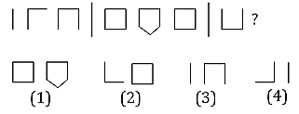
79. Look carefully at the sequence of symbols to find the pattern. Select correct pattern.
(a) 1 (b) 2 (c) 3 (d) 4

Slide 82
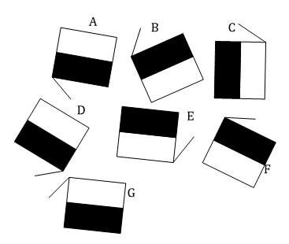
80. Which of these figures is wrong?
(a) C (b) D (c) A
(d) B (e) F (f) G

Slide 83
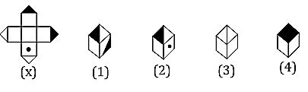
81. Choose the box that is similar to the box formed from the given sheet of paper (X).
(a) 1 and 2 only (b) 2 and 4 only
(c) 2 and 3 only (d) 1 and 4 only

Slide 84
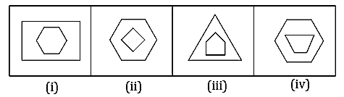
82. This question is based on the graphic shown below.
Which of the following figures is different from the others?
(a) (i)
(b) (ii)
(c) (iii)
(d) (iv)

Slide 85

83. How many triangles are there in the given diagram?
(a) 18
(b) 17
(c) 16
(d) 15

Slide 86
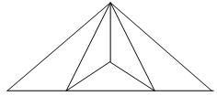
84. Find the number of triangles in the given image.
(a) 5
(b) 6
(c) 7
(d) 9

Slide 87
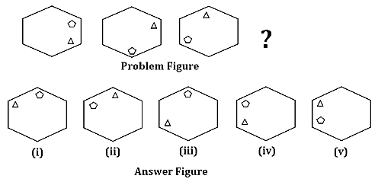
85. The figures displayed in the Problem Figure follow a specific pattern. Choose an image from the Answer Figure that will complete this series.
(a) (i) (b) (ii)
(c) (iii) (d) None of these

Slide 88
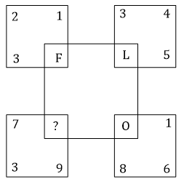
86. Which of the following letters should be there in place of “?” in the given image?
(a) P (b) R (c) S (d) T

Slide 89
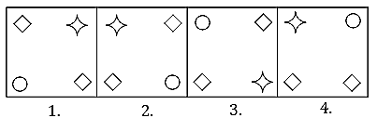
87. This question is based on the graphic shown below.
In the given image, identify the figure, which is different from the rest of the figures.
(a) 1
(b) 2
(c) 3
(d) 4

Slide 90
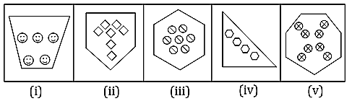
88. This equation is based on the graphic shown below.
Which of the following figures is different from the others?
(a) (i)
(b) (ii)
(c) (iii)
(d) (iv)
(e) (v)

Slide 91
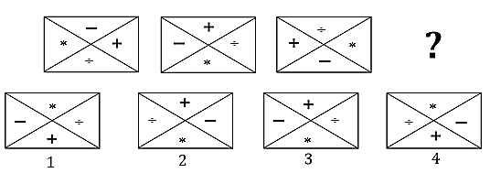
89. This question is based on the graphic shown below.
From the options given in the image, choose the one that completes the pattern.
(a) 1 (b) 2 (c) 3 (d) 4

Slide 92

90. The question is based on the graphic shown below.
Identify the odd one out image.
(a) (i)
(b) (ii)
(c) (iii)
(d) (iv)

Slide 93

91. Choose the alternative which is closely resembles the mirror image of the given combination.
(a) (1)
(b) (2)
(c) (3)
(d) (4)

Slide 94
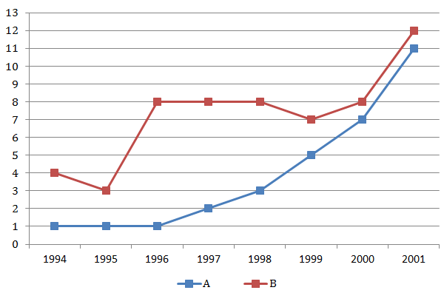
92. Study the following graph to answer the given questions;
Production of two companies A and B over the years:
(a) 75 (b) 50 (c) 25 (d) 10

Slide 95
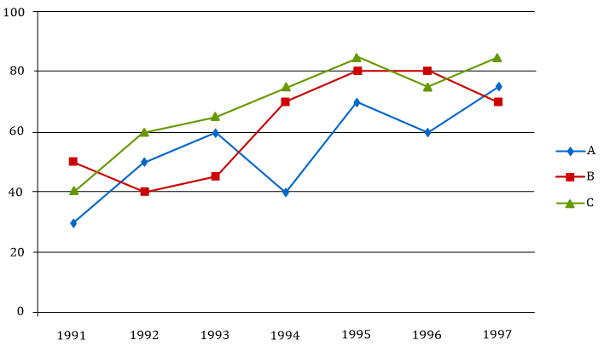
93. Study the following graph carefully and answer the question given below it:
Imports of 3 companies over the years (in Rs.crores)
In which of the following years-the imports made by company A was exactly equal to average imports made by it over the given years?
(a) 1992 (b) 1993 (c) 1994 (d) None of these

Slide 96
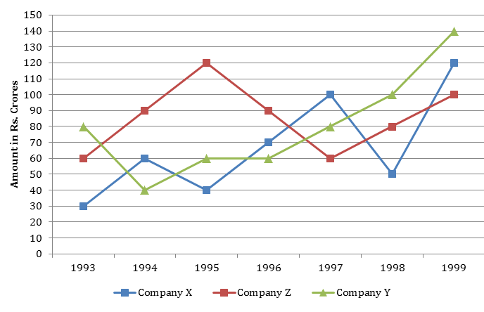
94. Study the following line graph and answer the questions.
Exports from Three Companies Over the Years (in Rs. Crore)
For which of the following pairs of years the total exports from the three Companies together are equal?
(a) 1995 and 1998 (b) 1996 and 1998
(c) 1997 and 1998 (d) 1995 and 1996

Slide 97
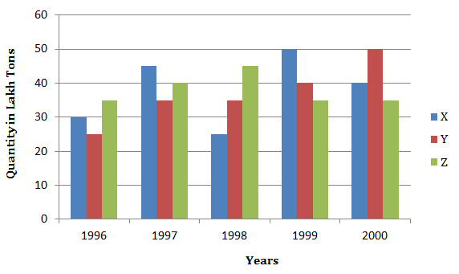
95. Production of paper (in lakh tonnes) by three companies X – Y and Z over the years. Study the graph and answer the questions that follow.
(a) 2,00,000 tons (b) 20,00,000 tons
(c) 20,000 tons (d) 2,00,00,000 tons

Slide 98
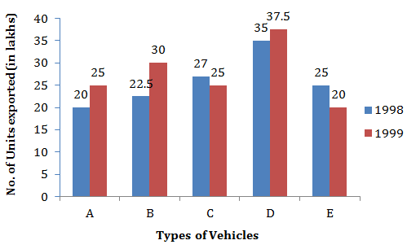
96. The graph shows the total number of the different types of vehicles (in lakh) exported by a company in 1998 and 1999. Study the graph carefully and answer these questions:
Total exports in 1998 and 1999 together was equal in case of which of the following pairs of types?
(a) A and E (b) A and D
(c) B and D (d) None of these

Slide 99
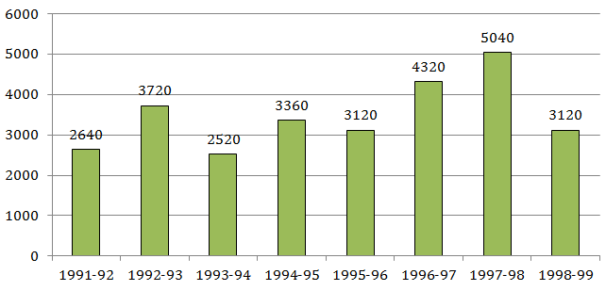
Directions for Q97 to Q101: The bar graph given below shows the foreign exchange reserves of a country (in million US $) from 1991-1992 to 1998-1999.
Foreign Exchange Reserves of a country. (in million US $)
97. The ratio of the number of years, in which the foreign exchange reserves are above the average reserves, to those in which the reserves are below the average reserves is
(a) 2:6 (b) 3:4 (c) 3:5 (d) 4:4

Slide 100
Directions for Q97 to Q101: The bar graph given below shows the foreign exchange reserves of a country (in million US $) from 1991-1992 to 1998-1999.
Foreign Exchange Reserves of a country. (in million US $)
98. The foreign exchange reserves in 1997-98 was how many times that is 1994-95?
(a) 0.7 (b) 1.2 (c) 1.4 (d) 1.5

Slide 101
Directions for Q97 to Q101: The bar graph given below shows the foreign exchange reserves of a country (in million US $) from 1991-1992 to 1998-1999.
Foreign Exchange Reserves of a country. (in million US $)
99. The foreign exchange reserves in 1996-97 were approximately what percent of the average foreign exchange reserves over the period under review?
(a) 95% (b) 110% (c) 115% (d) 125%

Slide 102
Directions for Q97 to Q101: The bar graph given below shows the foreign exchange reserves of a country (in million US $) from 1991-1992 to 1998-1999.
Foreign Exchange Reserves of a country. (in million US $)
100. In which year, the percent increase of foreign exchange reserves over the previous year, is the highest?
(a) 1992-93 (b) 1993-94 (c) 1994-95 (d) 1996-97

Slide 103
Directions for Q97 to Q101: The bar graph given below shows the foreign exchange reserves of a country (in million US $) from 1991-1992 to 1998-1999.
Foreign Exchange Reserves of a country. (in million US $)
101. What was the percentage increase in the foreign exchange reserves in 1997-98 over 1993-94?
(a) 100 (b) 150 (c) 200 (d) 620

Slide 104
102. It is 8.00 p.m. when can Hemant get next bus for Ramnagar from Dhanpur?
I. Buses for Ramnagar leave after every 30 minutes-till 10 p.m,
II. Fifteen minutes ago-one bus has left for Ramnagar.
(a) if the data in statement I alone are sufficient to answer the question;
(b) if the data in statement II alone are sufficient answer the question;
(c) if the data either in I or II alone are sufficient to answer the question;
(d) if the data in both the statement together are needed.

Slide 105
103. Carefully read and analyze the given two statements and select the appropriate option from the following.
Select option (A) as the answer option if Statement I is cause and Statement II is its effect.
Select option (B) as the answer option if Statement I is effect and Statement II is its cause.
Select option (C) as the answer option if both Statements I and II are independent causes.
Select option (D) as the answer option if Statements I and Ii are effects of a common cause.
Select option (E) as the answer option if Statements I and II are effects of independent causes.
Statements:
I. Mark’s health has been continuously deteriorating in the past one-and-a-half years.
II. Mark has decided to transfer his shares in the company to his brother.
(a) (A) (b) (B) (c) (C)
(d) (D) (e) (E)

Slide 106
104. What can you infer from the following statements, irrespective of the commonly known facts?
All liquids are pure. Some liquids are dark brown.
(a) All pure things are dark brown.
(b) No pure liquid is dark brown.
(c) All liquids are dark brown.
(d) None of the above.

Slide 107
Thank You …

